Slide 1
ORIGINS AND VISIONARIES 1945/1948

Slide 2
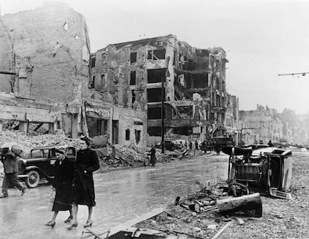
Seeds of unity before 1945: A CONTINENT IN TURMOIL
Europe devastated by two world wars, nationalism discredited
Intellectuals and politicians sought new frameworks to prevent future conflict
Early ideas of cooperation and federation emerged amid rising tensions

Slide 3
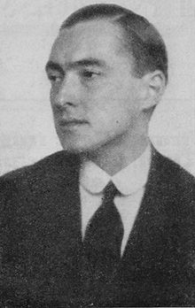
Count Richard von Coudenhove-Kalergi: The Pioneer of Pan-Europeanism
1923: Founded the Pan-European Movement advocating a united Europe
Published "Pan-Europa" manifesto promoting political and economic integration
Vision: a peaceful Europe transcending nationalism through federalism
Influenced European elites and inspired later integration efforts

Slide 4
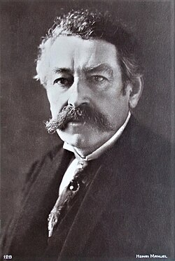
Aristides Briand’s 1929 Proposal for a European Federal Union
French Foreign Minister Briand proposed a "European Federal Union" to the League of Nations
Aimed to create a framework for economic cooperation and peace
Though unrealized, it marked the first official political call for European unity
Set precedent for supranational cooperation beyond nation-states

Slide 5
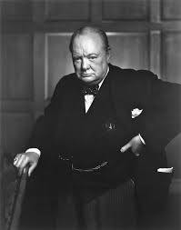
Winston Churchill’s 1946 Zurich Speech: "United States of Europe"
Delivered September 19, 1946, advocating a united Europe to secure peace
Called for a "Council of Europe" to foster cooperation among European nations
Emphasized reconciliation, especially Franco-German friendship
Though Britain initially stayed aloof, Churchill’s vision influenced European leaders

Slide 6
Stefan zweig: The world of yesterday: memoires of a european
The World of Yesterday by Stefan Zweig is more than a personal autobiography; it is a historical and emotional testimony of a Europe that disappeared in the first half of the twentieth century.
What emotions dominate these fragments, and how are they connected to the historical events taking place in Europe at the time?
How does Zweig define or suggest a concept of “European identity” in these texts and how does this identity differ from national or political identities?
What idea of a unified Europe emerges from these fragments, and to what extent is it presented as a lost dream, a moral ideal, or a possible future project?
4. Does Zweig’s nostalgia for pre-war Europe idealize the past, or does it function as a critical tool to warn future generations about political and moral decline?
WAR, SORROW, BORDERS, NATIONALISM, ESTRANGEMENT, UNSECURITY, HATE
EUROPEAN DREAM: PEACE, HAPPINESS, MOBILITY, SUPRANATIONALISM, BELONGING, SECURITY…

Slide 7
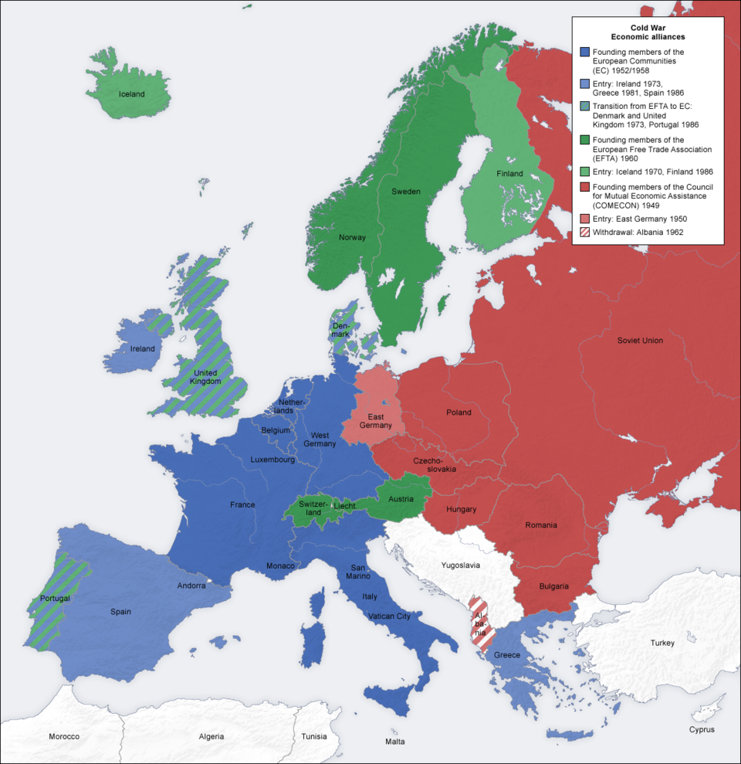
The Immediate Postwar Context (1945–1948): Devastation and Urgency
Europe in ruins: cities destroyed, economies shattered, millions displaced
Cold War tensions rising; Europe divided into Western and Soviet spheres
Urgent need for economic recovery and political stability
Western European leaders sought new forms of cooperation to rebuild and secure peace

Slide 8
Early Integration Ideas in 1946–1948: Foundations for the ECSC (Coal & steel)
1946: French Prime Minister Georges Bidault proposed a European customs union
1947: The Marshall Plan fostered economic cooperation and US support for European unity
1948: The Treaty of Brussels created Western Union for defense cooperation
These initiatives built trust and practical cooperation among Western European states
First institutional step for political cooperation: 1949. The Council of Europe

Slide 9
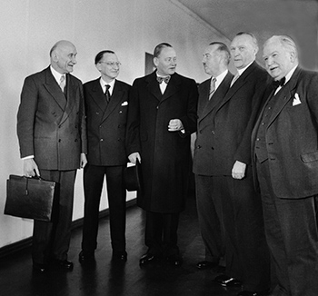
The Council of Europe (1949): First Institutional Step
Founded in 1949 to promote human rights, democracy, and rule of law
Included 10 founding members, including Britain and France
Not a supranational body but a forum for dialogue and cooperation
Laid groundwork for deeper integration efforts
https://www.youtube.com/watch?v=rl3gtHtJrL4

Slide 10
Conclusion: The Visionaries Who Laid Europe’s Foundations
Early 20th-century thinkers planted the idea of a united Europe amid conflict
Postwar leaders translated vision into concrete cooperation frameworks
Their legacy endures in today’s European Union, a unique peace project born from crisis
European integration remains a testament to the power of ideas and collaboration to transform history

